Slide 1

Unit-5 Advanced MongoDB Concepts
Database Management System-II (DBMS-II)
#2301CS401
Course Outcome (CO - 5) execute advanced level queries with document database mongoDB.
Prof. Firoz A. Sherasiya
Computer Science & Engineering Department
firoz.sherasiya@darshan.ac.in
9879879861

Slide 2

Looping
Outline
Regex
Aggregation
Indexes
Cursor
Schema Validation
Embedded Documents
Create user & add role in MongoDB
Backup and Recovery
Time Series
BASE Properties
The Cap Theorem
Replication and Sharding

Slide 3
Regex
Section – 1

Slide 4
Regex [RDBMS: like]
In SQL
Which clause is used for Pattern Matching?
LIKE clause
In MongoDB
Which clause is used for Pattern Matching?
Regex (Regular expression) clause
In SQL (Student)
Display the detail student whose Fname contains ‘Raj’.
SELECT * FROM student
WHERE Fname LIKE ‘%Raj%’
In MongoDB (Student)
{Rno: 101, FName: Raj, Lname: Patel}
{Rno: 102, FName: Rajesh, Lname: Shah}
{Rno: 103, FName: Meet, Lname: Dave}
{Rno: 104, FName: Mayur, Lname: Solanki}
{Rno: 105, FName: Hansraj, Lname: Dave}
Display the detail student whose Fname contains ‘Raj’.
db.student.find({FName:{$regex: "Raj"}})
OR
db.student.find({FName:/Raj/})
Rno | FName | LName
101 | Raj | Patel
102 | Rajesh | Shah
103 | Meet | Dave
104 | Mayur | Solanki
105 | Hansraj | Dave

Slide 5
Regex [RDBMS: like]
MongoDB provides the functionality to search a pattern in a string during a query by writing a regular expression.
A regular expression is a generalized way to match patterns with sequences of characters.
In MongoDB, we can do pattern matching in two different ways:
With $regex operator
Without $regex operator

Slide 6
Regex [RDBMS: like]
In MongoDB (Student)
{Rno: 101, FName: Raj, Lname: Patel}
{Rno: 102, FName: Rajesh, Lname: Shah}
{Rno: 103, FName: Meet, Lname: Dave}
{Rno: 104, FName: Mayur, Lname: Solanki}
{Rno: 105, FName: Hansraj, Lname: Dave}
Display the detail student whose Fname contains ‘Raj’. (Case insensitive)
db.student.find({FName:{$regex: "Raj“, $options:"i"}})
OR
db.student.find({FName:/Raj/i})

Slide 7
$regex [RDBMS: like]
This operator is used to search for the given string in the specified collection.
In MongoDB, the following <options> are available for use with regular expression:
i: To match both lower case and upper case pattern in the string.
m: To include ^ and $ in the pattern in the match i.e. to specifically search for ^ and $ inside the string. Without this option, these anchors match at the beginning or end of the string.
x: To ignore all white space characters in the $regex pattern.
s: To allow the dot character “.” to match all characters including newline characters.
Syntax
db.collectionName.find({field_name: { $regex: /pattern/, $options: '<options>' } })

Slide 8
Regex [RDBMS: like]
Displaying details of employee who are having the word developer in their position field.
Displaying details of employee who are a software engineer with case insensitive by using i <options>.
Displaying details of the employee whose name starts with ‘B’.
emp
{
name: "Tony",
position: "Backend developer"
}
{
name: "Bruce",
position: "frontend developer"
}
{
name: "Nick",
position: "HR Manager“
}
{
name: “Jimmy",
position: “backend developer"
}
Example
db.emp.find({position : {$regex : "developer"}})
Example
db.emp.find({position:{$regex:"software",$options:"i"}})
Example
db.emp.find({name:{$regex:"^B"}})

Slide 9
Regex [RDBMS: like]
Displaying details of the employee whose name ends with ‘e’.
Displaying details of the employee whose name starts with ‘B’ and ends with ‘e’.
Displaying details of the employee whose name have ‘r’ is second character.
emp
{
name: "Tony",
position: "Backend developer"
}
{
name: "Bruce",
position: "frontend developer"
}
{
name: "Nick",
position: "HR Manager“
}
{
name: “Jimmy",
position: “backend developer"
}
Example
db.emp.find({name : {$regex : “e$"}})
Example
db.emp.find({$and:[ {name:{$regex: "^B" }}, {name:{$regex: “e$"}}]})
Example
db.emp.find({ name: { $regex: "^.r" } })

Slide 10
Regex [RDBMS: like]
Displaying details of the employee whose name consist of c character at any place.
Displaying details of the employee whose name does not starts with B.
emp
{
name: "Tony",
position: "Backend developer"
}
{
name: "Bruce",
position: "frontend developer"
}
{
name: "Nick",
position: "HR Manager“
}
{
name: “Jimmy",
position: “backend developer"
}
Example
db.emp.find({name : {$regex : “c"}})
Example
db.emp.find({name: {$not: {$regex:"^B"}}})

Slide 11
Exercise (Write query in MongoDB)
MongoDB
Exercise
Find all products with name starting with "A“ from product collection.
db.product.find( {name: /^A/} )
Find all products containing "Galaxy" in their name from product collection.
db.product.find( {name: /Galaxy/} )
Find all products whose name contain "Mac" (case-insensitive).
db.product.find( {name: /Mac/i} )
Find products with name having "Pro" at the end.
db.product.find( {name: /Pro$/i} )
Find all products with price ending in 99.
db.product.find( {price:/99$/} )

Slide 12
Exercise (Write query in MongoDB)
MongoDB
Exercise
Find products where the name contains "1000".
db.product.find( {name:/1000/} )
Find products where the category is exactly "Laptops".
db.product.find( {category:/^Laptops$/} )
Find all products with a name that starts with "S" and ends with "5".
db.product.find( {name:/^S.*5$/} )
Find all products where name end with a digit.
db.product.find( {name:/\d$/} ) OR db.product.find( {name: {$regex:/[0-9]$/} })
Find products whose name have a space in them.
db.product.find( {name:/\s/} )

Slide 13
Aggregation
Section – 2

Slide 14
Aggregation [RDBMS: aggregate]
Aggregation means:
Taking many/more than one documents from a collection,
processing them step by step,
and producing a summarized or transformed result.
It is similar to GROUP BY in SQL but much more powerful.

Slide 15


Aggregation [RDBMS: aggregate]
Group by Gender
Name: Riya Patel
Gender: Female
Dept: CE
SPI: 8
Name: Jay Shah
Gender: Male
Dept: IT
SPI: 9
Name: Jiya Khan
Gender: Female
Dept: IT
SPI: 7
Name: Om Patel
Gender: Male
Dept: CE
SPI: 9
Name: Nita Patel
Gender: Female
Dept: CE
SPI: 10
Female
Male
Name: Riya Patel
Gender: Female
Dept: CE
SPI: 8
Name: Jiya Khan
Gender: Female
Dept: IT
SPI: 7
Name: Nita Patel
Gender: Female
Dept: CE
SPI: 10
Name: Jay Shah
Gender: Male
Dept: IT
SPI: 9
Name: Om Patel
Gender: Male
Dept: CE
SPI: 9

Slide 16
Aggregation [RDBMS: aggregate]
Why do we use Aggregation? We use aggregation when we want to:
Count documents
Group data
Calculate totals, averages, min, max
Filter records
Example questions aggregation can answer:
How many employees are in each department?
What is the total salary of each department?
What is the average marks of each class?
Who are the top 5 highest-paid employees?

Slide 17
Group by in SQL vs Aggregate in MongoDB
Student
Name | City | Gender | Dept | Sem
Raj | Rajkot | Male | CE | 3
Meet | Surat | Male | CE | 5
Jay | Rajkot | Male | CE | 3
Riya | Rajkot | Female | IT | 3
Jiya | Surat | Female | EC | 5
Syntax
db.collectionname.aggregate(pipeline, options)
Display the department-wise count of students in the CE and IT departments, where the count is greater than one, and sort the results by department.
pipeline
[
{ $match : { … } },
{ $group : { … } },
{ $match : { … } },
{ $sort : { … } }
]
SELECT Dept, COUNT(Name)
FROM Student
WHERE Dept IN (‘CE’, ‘IT’)
GROUP BY Dept
HAVING COUNT(Name)>1
ORDER BY Dept
WHERE
CONDITION
GROUP BY
GROUP
HAVING
CONDITION
ORDER BY
SORT

Slide 18
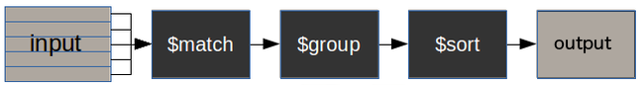
How does the MongoDB Aggregation pipeline work?
collectionName – is the name of a collection,
pipeline – is an array that contains the aggregation stages
options – optional parameters for the aggregation
$match stage – filters those documents we need to work with, those that fit our needs
$group stage – does the aggregation job
$sort stage – sorts the resulting documents the way we require (ascending or descending)
Syntax
pipeline
db.collectionname.aggregate(pipeline, options)
[
{ $match : { … } },
{ $group : { … } },
{ $sort : { … } }
]

Slide 19
Aggregation example [RDBMS: aggregate]
Count number of employee in emp collection.
Count department wise number of employees in emp collection.
Count gender wise number of employees in emp collection.
emp
Example
{_id : 1, FirstName : "Neha", Dept : “CE”, Gender: ’F’,
Salary: 10000},
{_id : 2, FirstName : "Milan", Dept : “IT”, Gender: ’M’,
Salary: 15000 },
{_id : 3, FirstName : "Sohan", Dept : “CE”, Gender: ’M’,
Salary: 12000 },
{_id : 4, FirstName : "Nehal", Dept : “CE”, Gender: ’F’,
Salary: 14000},
{_id : 5, FirstName : "Mitesh", Dept : “IT”, Gender: ’M’,
Salary: 17000},
{_id : 6, FirstName : “Ashok", Dept : “EC”, Gender: ’M’,
Salary: 19000}
db.emp.find().count()
Example
db.emp.aggregate([
{$group:{_id:"$Dept", EmployeeCount:{$sum:1}}} ])
Example
db.emp.aggregate([
{$group:{_id:"$Gender", EmployeeCount:{$sum:1}}} ])

Slide 20
Aggregation example [RDBMS: aggregate]
Display department wise total salary.
Display department wise maximum and minimum salary.
Display department wise average salary.
emp
Example
{_id : 1, FirstName : "Neha", Dept : “CE”, Gender: ’F’,
Salary: 10000},
{_id : 2, FirstName : "Milan", Dept : “IT”, Gender: ’M’,
Salary: 15000 },
{_id : 3, FirstName : "Sohan", Dept : “CE”, Gender: ’M’,
Salary: 12000 },
{_id : 4, FirstName : "Nehal", Dept : “CE”, Gender: ’F’,
Salary: 14000},
{_id : 5, FirstName : "Mitesh", Dept : “IT”, Gender: ’M’,
Salary: 17000},
{_id : 6, FirstName : “Ashok", Dept : “EC”, Gender: ’M’,
Salary: 19000}
db.emp.aggregate([
{"$group":{_id:"$Dept", TotalSalary:{$sum: "$Salary"}}} ])
Example
db.emp.aggregate([
{$group:{_id:"$Dept",
MaxSalary:{$max: "$Salary"}, MinSalary:{$min: "$Salary"}}} ])
Example
db.emp.aggregate([
{"$group":{_id:"$Dept", AvgSalary:{$avg:"$Salary"}}} ])

Slide 21
Aggregation example [RDBMS: aggregate]
Count gender wise department wise number of employees in a emp collection.
Display gender wise department wise maximum and minimum salary.
Display distinct values from the Dept field.
emp
{_id : 1, FirstName : "Neha", Dept : “CE”, Gender: ’F’,
Salary: 10000},
{_id : 2, FirstName : "Milan", Dept : “IT”, Gender: ’M’,
Salary: 15000 },
{_id : 3, FirstName : "Sohan", Dept : “CE”, Gender: ’M’,
Salary: 12000 },
{_id : 4, FirstName : "Nehal", Dept : “CE”, Gender: ’F’,
Salary: 14000},
{_id : 5, FirstName : "Mitesh", Dept : “IT”, Gender: ’M’,
Salary: 17000},
{_id : 6, FirstName : “Ashok", Dept : “EC”, Gender: ’M’,
Salary: 19000}
Example
db.emp.aggregate([
{$group:{_id: { Dept: "$Dept", Gender: "$Gender" },
EmployeeCount:{$sum:1}}} ])
Example
db.emp.aggregate([
{$group:{_id: { Dept: "$Dept", Gender: "$Gender" },
MaxSalary:{$max: "$Salary"}, MinSalary:{$min: "$Salary"}}} ])
Example
db.emp.aggregate([{"$group":{_id:"$Dept"}} ])

Slide 22
Aggregation example [RDBMS: aggregate]
Count number of employees in CE department from emp collection.
Count department wise number of employees in a emp collection and display departments having more than one employee.
emp
{_id : 1, FirstName : "Neha", Dept : “CE”, Gender: ’F’,
Salary: 10000},
{_id : 2, FirstName : "Milan", Dept : “IT”, Gender: ’M’,
Salary: 15000 },
{_id : 3, FirstName : "Sohan", Dept : “CE”, Gender: ’M’,
Salary: 12000 },
{_id : 4, FirstName : "Nehal", Dept : “CE”, Gender: ’F’,
Salary: 14000},
{_id : 5, FirstName : "Mitesh", Dept : “IT”, Gender: ’M’,
Salary: 17000},
{_id : 6, FirstName : “Ashok", Dept : “EC”, Gender: ’M’,
Salary: 19000}
Example
db.emp.aggregate([
{$match: { Dept: "CE" } },
{$group:{_id:"$Dept", count: {$sum: 1}}} ])
Example
db.emp.aggregate([
{"$group":{_id:"$Dept", qty:{$sum:1}}},
{$match: { qty: {$gt: 1} } }])

Slide 23
Aggregation example [RDBMS: aggregate]
Count department wise number of employees in a emp collection and sort the output on number of employee in ascending order.
emp
{_id : 1, FirstName : "Neha", Dept : “CE”, Gender: ’F’,
Salary: 10000},
{_id : 2, FirstName : "Milan", Dept : “IT”, Gender: ’M’,
Salary: 15000 },
{_id : 3, FirstName : "Sohan", Dept : “CE”, Gender: ’M’,
Salary: 12000 },
{_id : 4, FirstName : "Nehal", Dept : “CE”, Gender: ’F’,
Salary: 14000},
{_id : 5, FirstName : "Mitesh", Dept : “IT”, Gender: ’M’,
Salary: 17000},
{_id : 6, FirstName : “Ashok", Dept : “EC”, Gender: ’M’,
Salary: 19000}
Example
db.emp.aggregate([
{"$group":{_id:"$Dept", qty:{$sum:1}}},
{$sort: { qty : 1}} ])

Slide 24
Aggregation example [RDBMS: aggregate]
Count number of employees in CE department from emp collection.
Count department wise number of employees in a emp collection and display departments having more than one employee.
emp
{_id : 1, FirstName : "Neha", Dept : “CE”, Gender: ’F’,
Salary: 10000},
{_id : 2, FirstName : "Milan", Dept : “IT”, Gender: ’M’,
Salary: 15000 },
{_id : 3, FirstName : "Sohan", Dept : “CE”, Gender: ’M’,
Salary: 12000 },
{_id : 4, FirstName : "Nehal", Dept : “CE”, Gender: ’F’,
Salary: 14000},
{_id : 5, FirstName : "Mitesh", Dept : “IT”, Gender: ’M’,
Salary: 17000},
{_id : 6, FirstName : “Ashok", Dept : “EC”, Gender: ’M’,
Salary: 19000}
Example
db.emp.aggregate([
{$match: { Dept: "CE" } },
{$group:{_id:"$Dept", count: {$sum: 1}}} ])
Example
db.emp.aggregate([
{"$group":{_id:"$Dept", qty:{$sum:1}}},
{$match: { qty: {$gt: 1} } }])

Slide 25
Aggregation example [RDBMS: aggregate]
Count department wise number of employees in a emp collection and sort the output on number of employee in ascending order.
emp
{_id : 1, FirstName : "Neha", Dept : “CE”, Gender: ’F’,
Salary: 10000},
{_id : 2, FirstName : "Milan", Dept : “IT”, Gender: ’M’,
Salary: 15000 },
{_id : 3, FirstName : "Sohan", Dept : “CE”, Gender: ’M’,
Salary: 12000 },
{_id : 4, FirstName : "Nehal", Dept : “CE”, Gender: ’F’,
Salary: 14000},
{_id : 5, FirstName : "Mitesh", Dept : “IT”, Gender: ’M’,
Salary: 17000},
{_id : 6, FirstName : “Ashok", Dept : “EC”, Gender: ’M’,
Salary: 19000}
Example
db.emp.aggregate([
{"$group":{_id:"$Dept", qty:{$sum:1}}},
{$sort: { qty : 1}} ])

Slide 26
Exercise (Aggregate | $group)
MongoDB
Exercise
Employee
{_id, Name, Gender, Age, City, Department, Salary, Incentive}
Display Gender wise employee’s count.
db.Employee.aggregate([{$group:{_id:"$Gender", EmployeeCount:{$sum:1}}}])
Display Gender wise employee’s total salary.
db.Employee.aggregate([{$group:{_id:"$Gender", TotalSalary:{$sum:’$Salary’}}}])
Display Department wise employee’s Maximum and Minimum salary.
db.Employee.aggregate([{$group:{_id:"$Department", MaxSalary:{$max:'$Salary’}, MinSalary:{$min:'$Salary'}}}])
Display Gender wise City wise employee’s count.
db.Employee.aggregate([{$group:{_id:{Gender: ‘$Gender’, City: ‘$City'}, EmployeeCount:{$sum:1}}}])
Display unique Department names.
db.Employee.aggregate([{$group:{_id:{Department: "$Department”}}}])

Slide 27
Exercise (Aggregate | $group and $match)
MongoDB
Exercise
Employee
{_id, Name, Gender, Age, City, Department, Salary, Incentive}
Display Male employee’s count.
db.Employee.aggregate([{$match: {Gender: ‘Male’}}, {$group:{_id:"$Gender", EmployeeCount:{$sum:1}}}])
Display Gender wise employee’s count, consider the employees whose salary is more than 10000.
db.Employee.aggregate([{$match:{Salary:{$gt:10000}}},{$group:{_id:"$Gender",EmployeeCount:{$sum:1}}}])
Display Department wise employee’s count of IT and AI department using IN operator.
db.Employee.aggregate([{$match:{Dept:{$in:’IT’,’AI']}}},{$group:{_id:"$Department",EmployeeCount:{$sum:1}}}])
Display City wise employee’s count and display city having more than 5 employee.
db.Employee.aggregate([{$group:{_id:{City: ‘$City'}, ECount:{$sum:1}}}, {$match: {Ecount: {$gt: 5}}}])
Display City wise employee’s count and sort the output on EmployeeCount in ascending order.
db.Employee.aggregate ([{$group:{_id:{City: ‘$City'}, ECount:{$sum:1}}}, {$sort: {Ecount: 1}}])

Slide 28
Indexes
Section – 3

Slide 29
Indexes [RDBMS: index]
Indexes support the efficient resolution of queries.
Without indexes, MongoDB must scan every document of a collection to select those documents that match the query statement.
This scan is highly inefficient and require MongoDB to process a large volume of data.
Indexes are special data structures, that store a small portion of the data set in an easy-to-traverse form.
The index stores the value of a specific field or set of fields, ordered by the value of the field as specified in the index.
Here key is the name of the field on which you want to create index and 1 is for ascending order.
To create index in descending order you need to use -1.
Syntax
db.collectionName.createIndex({KEY:1})

Slide 30
Indexes [RDBMS: index]
Create an index on “FirstName” on emp collection.
Retrieves all the indexes in the collection emp.
Drop an index created on “FirstName” from emp collection.
How to check which index is used by the find method.
emp
Example
{_id : 1, FirstName : "Neha", Dept : “CE”,
Joiningdate: 2023-07-10T05:31:14.168Z},
{_id : 2, FirstName : "Milan", Dept : “IT”,
Joiningdate: 2023-07-10T05:31:14.168Z },
{_id : 3, FirstName : "Sohan", Dept : “CE”,
Joiningdate: 2023-07-10T05:31:14.168Z },
{_id : 4, FirstName : "Nehal", Dept : “CE”,
Joiningdate: 2023-07-10T05:31:14.168Z},
{_id : 5, FirstName : "Mitesh", Dept : “IT”,
Joiningdate: 2023-07-10T05:31:14.168Z },
{_id : 6, FirstName : “Ashok", Dept : “EC”,
Joiningdate: 2023-07-10T05:31:14.168Z }
db.emp.createIndex({FirstName: 1})
Example
db.emp.getIndexes()
Example
db.emp.dropIndex({FirstName: 1})
Example
db.emp.find({FirstName: “Neha”}) .explain("executionStats")

Slide 31
Indexes [RDBMS: index]
Single Field Index / Index on one field:
Compound Index / Index on multiple fields (Used when query uses multiple fields)
Example
db.students.createIndex({ name: 1 })
Example
db.students.createIndex({ dept: 1, marks: -1 })

Slide 32
Indexes [RDBMS: index]
Advantages of Index
Fast searching
Fast sorting
Improves performance usually in find method
Disadvantages of Index
Takes extra storage
Slows down insert/update (because index also updates)

Slide 33
Cursor
Section – 4

Slide 34
Cursor
A cursor in MongoDB is a pointer to the result set of a query.
When you run a find() query, MongoDB does not return all documents at once. Instead, it returns a cursor that allows you to iterate through the results.
What is a Cursor?
db.students.find()
👉 This does NOT immediately return all documents.
👉 It returns a cursor object.
The cursor fetches documents in batches.
The following example gets the cursor object and assign it to a variable.
To display the content of a cursor.
Syntax
Example
var cursor_name = db.collection_name.find()
var emp = db.employees.find()
Syntax
Example
cursor_name
emp

Slide 35
Why Cursor is Needed?
Imagine collection has 10 lakh documents.
If MongoDB returned everything at once:
❌ High memory usage
❌ Slow performance
❌ Possible system crash
❌ Network overload
So MongoDB:
Returns results in batches
Fetches more data only when needed
This makes it efficient.

Slide 36
Cursor
cursor.next() returns the next document from the result set.
cursor.forEach() iterates the cursor means loops through all documents.
Checks if more documents exist.
Example
emp.next()
Example
emp.(forEach(printjson))
Example
emp.hasNext()

Slide 37
Schema Validation
Section – 5

Slide 38
Schema Validation [RDBMS: validation]
Schema validation in MongoDB is a feature that allows you to enforce rules on documents inserted or updated in a collection.
It ensures that documents follow a defined structure (schema).
Why Schema Validation is Needed?
MongoDB is a NoSQL database, which means:
It is schema-less by default.
Documents in the same collection can have different structures.

Slide 39
Schema Validation [RDBMS: validation]
Features of Schema Validation Schema validation can enforce:
Data type (bsonType)
Required fields
Minimum / Maximum values
String length (minLength, maxLength)
Enum values
Restrict extra fields (additionalProperties)
Nested object structure
Advantages:
Maintains data consistency
Prevents invalid data
Improves data integrity
Makes MongoDB behave more like SQL (structured)

Slide 40
Schema Validation [RDBMS: validation]
Components of the Validator
$jsonSchema
Each document must be a JSON object.
bsonType
Specifies the data type of the field. Common types:
string, int, double, bool, date, array, object
required
Defines mandatory fields.
properties
Lists validation rules for each field.
minimum / maximum
Sets constraints on numeric values.
Syntax
db.createCollection(
"collection_name", {
validator: {
$jsonSchema:
bsonType: datatype,
required: [mandatory fields],
properties: {Validation rules}
}})

Slide 41
Schema Validation [RDBMS: validation]
Components of the Validator
$jsonSchema
Each document must be a JSON object.
bsonType
Specifies the data type of the field. Common types:
string, int, double, bool, date, array, object
required
Defines mandatory fields.
properties
Lists validation rules for each field.
minimum / maximum
Sets constraints on numeric values.
Example
db.createCollection("emp", {
validator: {
$jsonSchema: {
bsonType: "object",
required: [ "eid", "ename" ],
properties: {
eid: {bsonType: "int", minimum:1, maximum:10},
ename: {bsonType: "string", minLength:3, maxLength:30},
city: {bsonType: "string"},
status: {
enum: ["active", "inactive", "blocked"],
description: "can only be one of the enum values"
}}}}})

Slide 42
Schema Validation [RDBMS: validation]
Components of the Validator
$jsonSchema
Each document must be a JSON object.
bsonType
Specifies the data type of the field. Common types:
string, int, double, bool, date, array, object
required
Defines mandatory fields.
properties
Lists validation rules for each field.
minimum / maximum
Sets constraints on numeric values.
Example
db.createCollection("emp",{
validator: {
$jsonSchema:{
bsonType: "object",
required: [ "_id", "ename" ],
properties:{
_id: {bsonType: "int", minimum:1, maximum:10},
ename: {bsonType: "string"}
},
additionalProperties: false
}
}
})

Slide 43
Schema Validation [RDBMS: validation]
Components of the Validator
$jsonSchema
Each document must be a JSON object.
bsonType
Specifies the data type of the field. Common types:
string, int, double, bool, date, array, object
required
Defines mandatory fields.
properties
Lists validation rules for each field.
minimum / maximum
Sets constraints on numeric values.
Example
db.createCollection("empdata", {
validator: {
$jsonSchema: {
required: [ "eid", "ename" ]
}}})
db.getCollectionInfos({name:"emp"})

Slide 44
Schema Validation [RDBMS: validation]
Example
db.createCollection("emp", {
validator: {
$jsonSchema: {
bsonType: "object",
required: [ "_id", "name", "city", "SPI", "BL", "Pass" ],
properties: {
_id: {bsonType: "int", minimum:1, maximum:50},
name: {bsonType: "string", minLength:3, maxLength:15},
city: {bsonType: "string"},
SPI: {bsonType: "double", minimum:1, maximum:10},
BL: {bsonType: "int", minimum:0},
Pass: {bsonType: "bool"}},
additionalProperties: false
}}})

Slide 45
Embedded or Nested Document
Section – 6

Slide 46
Embedded or Nested Document
Embedded document or nested documents are those types of documents which contain a document inside another document.
Or in other words, when a collection has a document, this document contains another document, another document contains another sub-document, and so on, then such types of documents are known as embedded/nested documents.
Notes –
In MongoDB, you can only nest document up to 100 levels.
The overall document size must not exceed 16 MB.

Slide 47
Creating Embedded or Nested Document
In MongoDB, we can easily embed a document inside another document.
As we know that in the mongo shell, documents are represented using curly braces ( {} ) and inside these curly braces we have field-value pairs.
Now inside these fields, we can embed another document using curly braces {} and this document may contain field-value pairs or another sub-document.
Query on Embedded/Nested Documents
Syntax
Example
{
....
field: {field1: value1, field2: value2}
....
}
db.student.insertOne({
Name: {Fname:'Raj’, Lname:'Mehta’},
City:'Rajkot'})
Example
db.student.find({"Name.Fname": ‘Raj'})

Slide 48
Create user & add role in MongoDB
Section – 7

Slide 49
Create user & add role in MongoDB
In MongoDB, we are allowed to create new users for the database.
Every MongoDB user only accesses the data that is required for their role.
A role in MongoDB grants privileges to perform some set of operations on a given resource.
In MongoDB, users are created using createUser() method.
This method creates a new user for the database, if the specified user is already present in the database then this method will return an error.
Syntax
Example
db.createUser(
{ user: “username",
pwd: “password",
roles:[
{role: “roles" ,
db:“database"}]})
db.createUser(
{ user: "firoz",
pwd: "baba",
roles:[
{role: "read" ,
db:"test"}]})

Slide 50
List the user & drop/delete user
To list all users, use mongosh to query the system.users collection.
To remove a user from a MongoDB database use dropUser method.
Syntax
Syntax
use admin
db.system.users.find()
show users
Example
db.dropUser(“username”)

Slide 51
Backup and Recovery
Section – 8

Slide 52
Backup
In MongoDB, backup and restore are usually done using two command-line tools:
mongodump → Used to take backup
mongorestore → Used to restore backup
Taking Backup in MongoDB (mongodump)
-d → database OR --db → database
-c → collection OR --collection → collection
--out → Location where backup will be stored
Syntax
mongodump -d databaseName -c collectionName --out c:\backup OR
mongodump --db databaseName --collection collectionName --out c:\backup

Slide 53
Backup Example
Taking Backup in MongoDB (mongodump)
--db college → Database name
--collection student → Collection name
--out D:\backup → Location where backup will be stored (MongoDB automatically creates a dump folder)
After backup, folder structure will look like:
.bson → Actual data
.json → Collection metadata (indexes etc.)
Example
mongodump --db college --collection student --out c:\backup
C:\backup
└── college
├── students.bson
├── students.metadata.json
├── faculty.bson

Slide 54
Restore
In MongoDB, backup and restore are usually done using two command-line tools:
mongodump → Used to take backup
mongorestore → Used to restore backup
Taking Backup in MongoDB (mongodump)
-d → database OR --db → database
-c → collection OR --collection → collection
path → Location from where backup will be restored
Syntax
mongorestore -d databaseName -c collectionName path OR
mongorestore --db databaseName --collection collectionName path

Slide 55
Backup Example
Taking Backup in MongoDB (mongodump)
--db college → Database name
--collection student → Collection name
c:\backup → Location from where backup will be restored
Example
mongodump --db college --collection student c:\backup

Slide 56
Time series
Section - 9

Slide 57
Time series
Time series data is a collection of numeric values recorded over time at regular intervals.
It can be use to understand the past and make predictions about the future.
Examples of Time Series data
Financial time series data(Socket Market)
Weather data
Other examples of time series data:
IoT Sensor Data (Smart Devices)
Traffic Data
Sales and Revenue Data
Electricity Consumption Data
Cryptocurrency Price Data
Date | Company | Open | High | Low | Close | Volume
2024-02-15 | TCS | 150.25 | 152.80 | 149.50 | 151.30 | 1,200,000
2024-02-16 | TCS | 151.40 | 153.00 | 150.80 | 152.50 | 1,100,000
2024-02-17 | TCS | 152.60 | 154.20 | 151.90 | 153.80 | 950,000
Timestamp | Temperature (°C) | Humidity (%) | Wind Speed (km/h) | Rainfall (mm)
2024-02-15 06:00 | 12.5 | 80 | 10 | 0.0
2024-02-15 12:00 | 18.2 | 60 | 15 | 0.5
2024-02-15 18:00 | 14.8 | 70 | 12 | 0.2

Slide 58
BASE Theorem
Section - 10

Slide 59
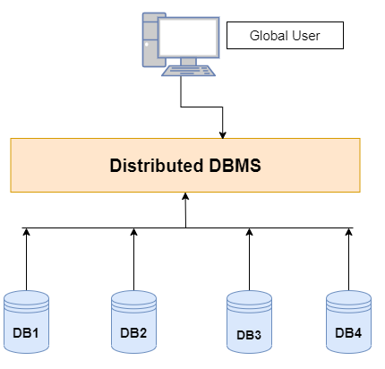
BASE Theorem
BASE stands for:
BA – Basically Available S – Soft State E – Eventual Consistency
MongoDB follows the BASE model to provide better performance, scalability, and distributed database system.
A distributed database is a system where data is stored across multiple physically separated locations (nodes) but managed as a single, cohesive database.

Slide 60


BASE Theorem | Basically Available
The system always remains available even if some parts of the system fail.
The database will still respond to requests.
Data may not always be perfectly consistent, but the system continues to operate.
Example: If one node in a MongoDB cluster fails, other nodes still serve the requests.
X=500
X=500
X=500
X=500
X=500
X=500
X=500

Slide 61
BASE Theorem | Soft State
The state of the system may change over time even without new input because of replication or synchronization.
Data in different nodes may temporarily differ.
The system is continuously updating and synchronizing data.
Example: In MongoDB replication, the secondary node may temporarily have older data than the primary node.
X=500
X=800
X=800
X=500
X=500
X=800
Upadate X=800
X=800
X=500
X=500
X=500
X=800
X=500
X=800

Slide 62
BASE Theorem | Eventual Consistency
Eventually, all nodes in the system will become consistent.
After some time, all replicas will have the same data.
Temporary inconsistencies are allowed.
Example: When data is inserted or updated in the primary node, secondary nodes will eventually receive the same data through replication.
X=500
X=800
X=800
X=500
X=500
X=800
Upadate X=800
X=800
X=500
X=500
X=500
X=800
X=500
X=800

Slide 63
BASE Theorem
BASE stands for Basically Available, Soft State, and Eventual Consistency.
Basically Available (The system is designed to be available as much as possible.)
This property refers to the fact that the database system should always be available to respond to user requests even in the event of failure.
Rather than enforcing immediate consistency, BASE-modelled NoSQL databases will ensure availability of data by spreading and replicating it across the nodes of the database cluster.
Soft State (The state of the system can change over time, even without input.)
This property refers to the fact that the state of the database can change over time, even without any explicit user intervention.
This can happen due to the effects of background processes, updates to data, and other factors.
The database should be designed to handle this change gracefully, and ensure that it does not lead to data corruption or loss.
Eventual Consistency (The system will eventually become consistent.)
The fact that BASE does not obligates immediate consistency but it does not mean that it never achieves it.
The system will eventually become consistent once it stops receiving input.

Slide 64
BASE Theorem
Where BASE Databases can be used?
BASE databases are used in modern, highly-available, and scalable systems that handle large amounts of data.
Examples of such systems include online shopping websites, social media platforms, and cloud-based services.

Slide 65
CAP Theorem
Section - 11

Slide 66
CAP Theorem
The CAP Theorem is an important concept for distributed databases like MongoDB. It explains the trade-off between three properties in distributed systems.
CAP stands for:
C – Consistency
A – Availability
P – Partition Tolerance
The theorem states that a distributed database system can guarantee only two out of these three properties at the same time.
A distributed database is a system where data is stored across multiple physically separated locations (nodes) but managed as a single, cohesive database.

Slide 67
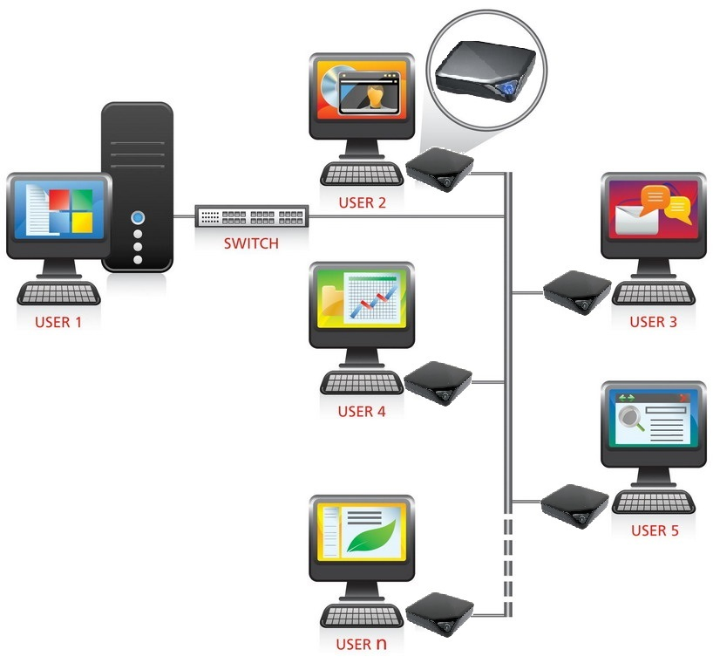
CAP Theorem | Consistency
Consistency means all nodes in the system return the same data at the same time.
When data is updated, every user immediately sees the latest updated value.
No outdated data should be returned.
Example: If a document is updated by user1 in MongoDB:
db.students.updateOne( {name:"Ali"}, {$set:{marks:90}})
All nodes should update marks = 90 immediately for Ali.
emp
db.students.updateOne( {name:"Ali"}, {$set:{marks:90}} )

Slide 68
CAP Theorem | Availability
Availability means every request receives a response, even if some nodes fail.
The system continues to work.
The response may not always contain the most recent data.
Example: If one MongoDB server fails, another server still handles user queries.
emp
db.students.findOne( {name:"Ali"} )

Slide 69
CAP Theorem | Partition Tolerance
Partition tolerance means the system continues to operate even if communication between nodes is lost.
A network partition occurs when nodes cannot communicate due to network failure.
Example:
In a MongoDB cluster:
Primary node in Server A
Secondary node in Server B
If the network between them breaks, the system still tries to operate.

Slide 70
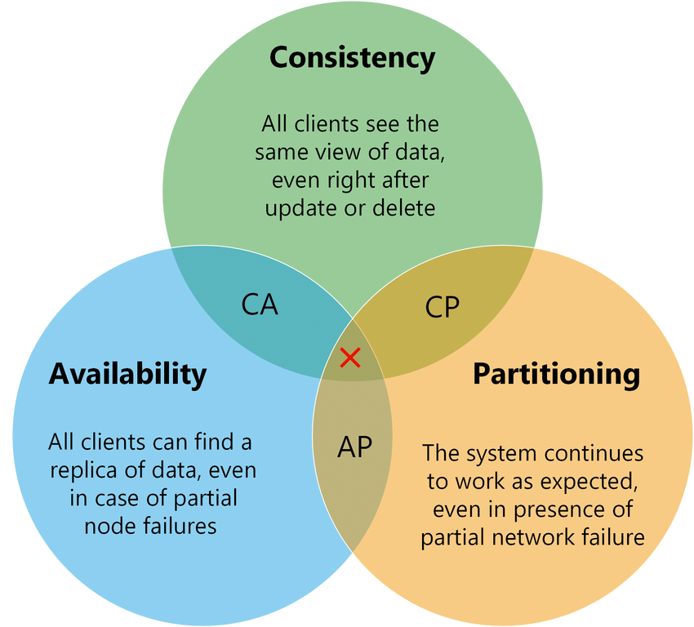
CAP Theorem Rule
The CAP theorem states that a distributed system can provide only two of three desired properties: consistency, availability, and partition tolerance.
But C + A + P together is impossible.

Slide 71
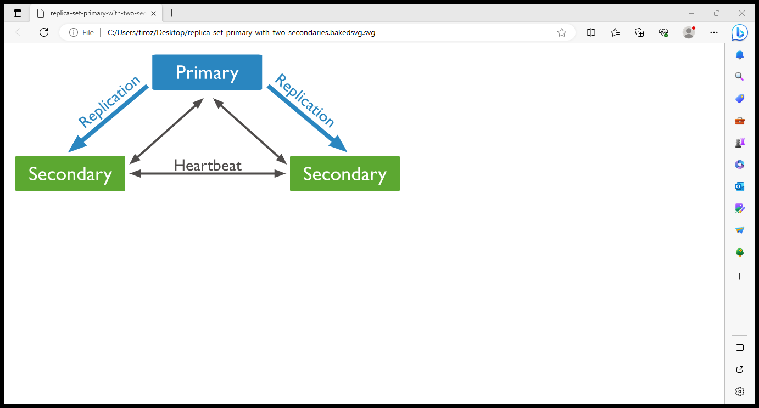
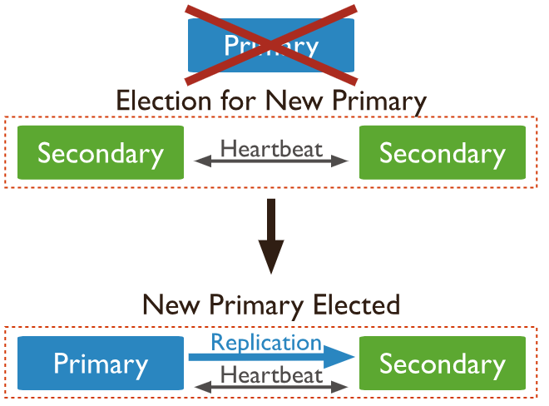
CAP Theorem | CP (Consistency + Partition Tolerance) with MongoDB
MongoDB mainly follows:
CP (Consistency + Partition Tolerance)
Explanation:
MongoDB maintains strong consistency in the primary node.
Can handle network partitions using replica sets.
Availability may be temporarily reduced during failover.
Example:
If the primary node fails:
MongoDB performs automatic election.
A secondary node becomes the new primary.
During election, the system may temporarily stop accepting writes.
So MongoDB prioritizes:
Consistency + Partition tolerance.

Slide 72
Example | CP (Consistency + Partition Tolerance) with MongoDB
Suppose there are 3 nodes in a MongoDB replica set:
Node A – Primary
Node B – Secondary
Node C – Secondary
If the network breaks between Node A and the others:
MongoDB may elect a new primary.
Writes are stopped temporarily to maintain data consistency.
This shows CP behavior.

Slide 73
Replication and Sharding
Section - 12

Slide 74
Replication and Sharding
In MongoDB, Replication and Sharding are two important techniques used to improve availability, reliability, and scalability of the database.

Slide 75
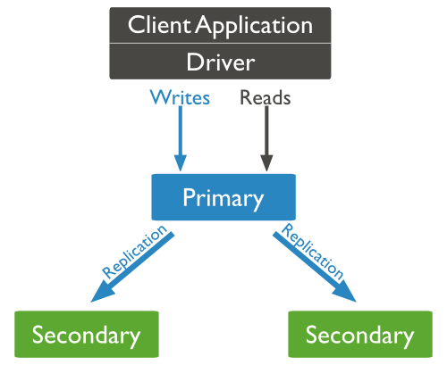
Replication
Replication is the process of copying and maintaining the same data on multiple servers (nodes) to ensure high availability and fault tolerance.
MongoDB uses a Replica Set for replication.
Components of Replica Set
Primary Node
Receives all write operations (insert, update, delete).
Sends data to secondary nodes.
Secondary Nodes
Copy data from the primary node.
Used for backup and read operations.
Arbiter (optional)
Participates in election but does not store data.

Slide 76
Replication
How Replication Works
Data is written to the Primary node.
The operation is recorded in an oplog (operation log).
Secondary nodes read the oplog and replicate the same changes.
If the primary node fails, a secondary node becomes the new primary automatically.
Example
Replica set with three servers:
Primary (Server A) | replication ↓ Secondary (Server B) Secondary (Server C)
If Server A fails, MongoDB performs an automatic election and one secondary becomes the new primary.
Server A
Server B
Server C
Server B
Server C

Slide 77
Replication
Advantages of Replication
High availability
Data backup and recovery
Automatic failover
Improved read performance

Slide 78
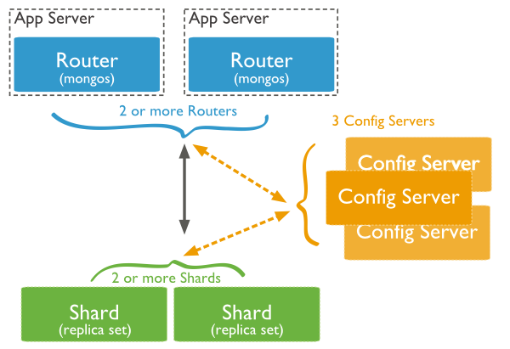
Sharding
Sharding is the process of distributing data across multiple servers to handle large datasets and high traffic.
Instead of storing all data on one server, MongoDB splits the data into smaller parts called shards.
Components of Sharded Cluster
Shard
Stores a portion of the data.
Config Server
Stores metadata about the cluster.
Query Router (mongos)
Routes client requests to the correct shard.

Slide 79
Sharding
Example
Suppose a collection contains 1 crore documents.
Without sharding:
Server A All 1 crore records
With sharding:
Shard 1 → records 1–30 lakh Shard 2 → records 31–60 lakh Shard 3 → records 61–100 lakh
Each shard stores only part of the data.

Slide 80
Sharding
Advantages of Sharding
Handles very large databases
Improves system performance
Enables horizontal scaling
Distributes load across multiple servers

Slide 81
Database Management System-II (DBMS-II)
#2301CS401
Prof. Firoz A. Sherasiya
Computer Science & Engineering Department
firoz.sherasiya@darshan.ac.in
9879879861

